Slide 1
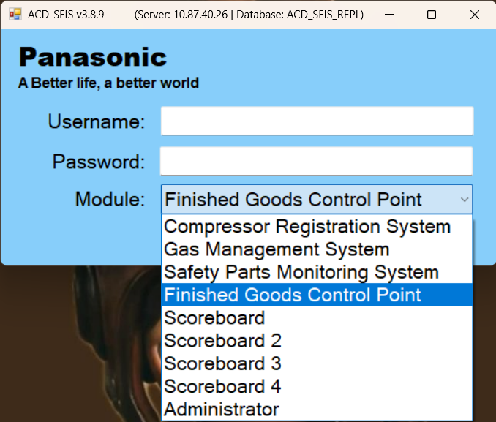
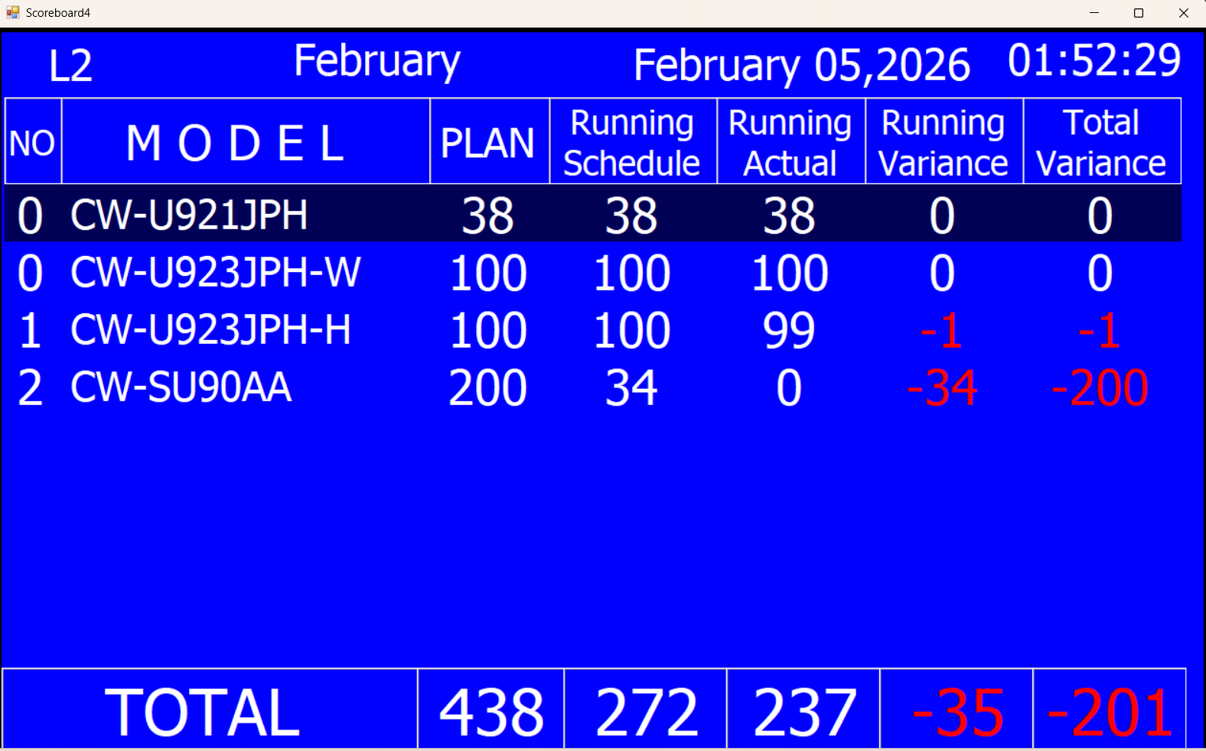
DATA LOGGER PROJECT
Log-in
Username:
Currently the username that we use differs per line (example for Line 1 is sfisline1, for Line 2 is sfisline2
Module: Each module represents the different SFIS (example Compressor Registration System is SFIS 1)
Scoreboards shows the current number plan, running sched, and other quantity.
Administrator is where we can schedule the plan, and input the parts.

Slide 2
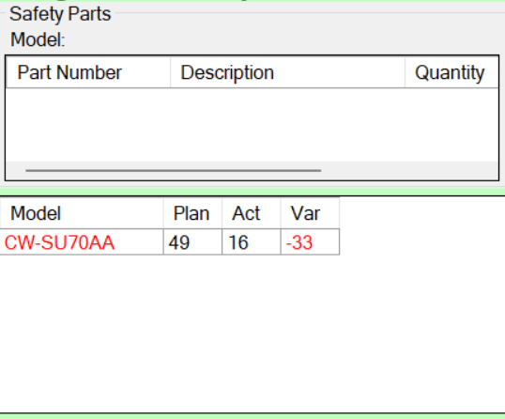
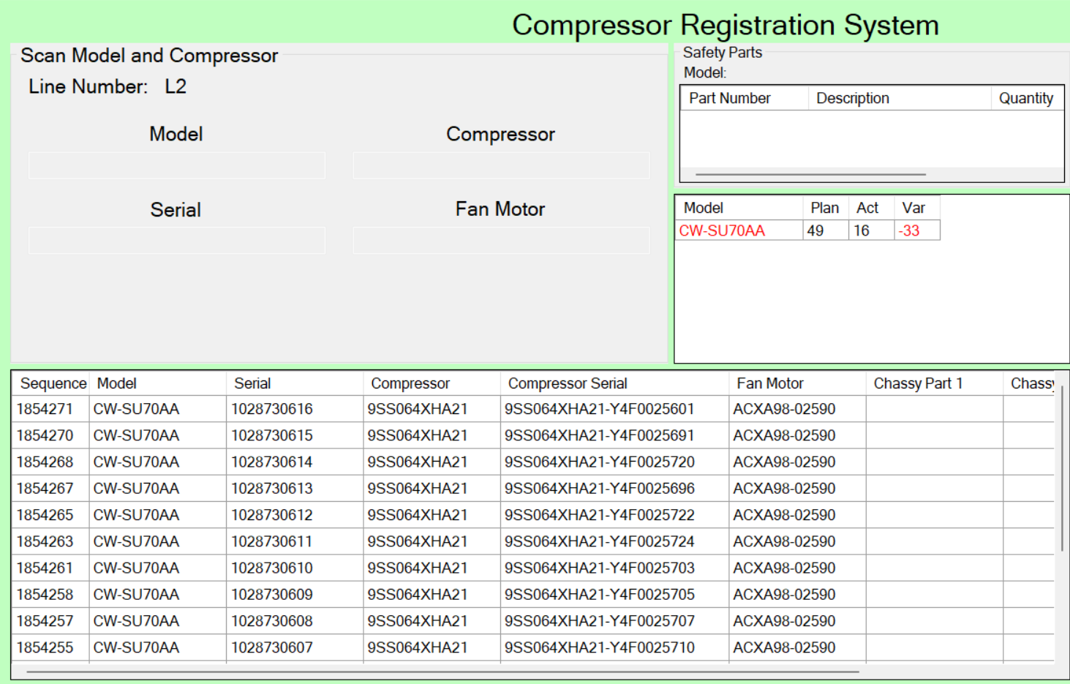
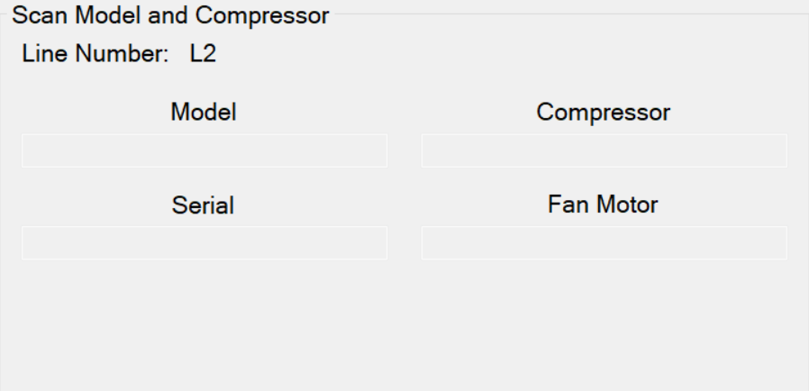
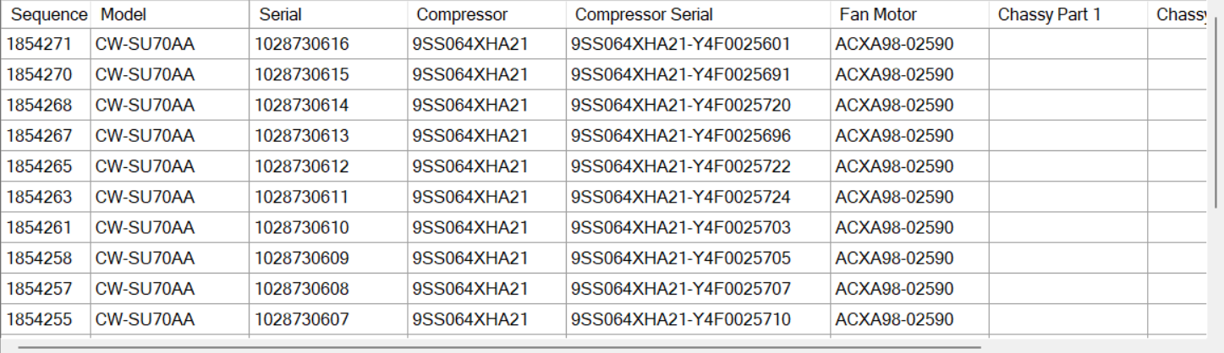
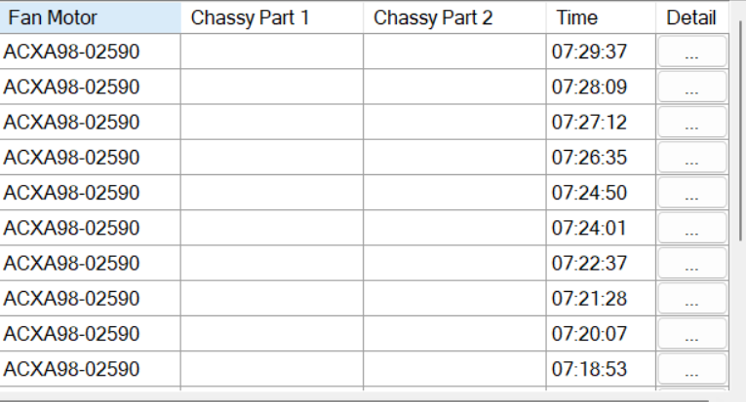
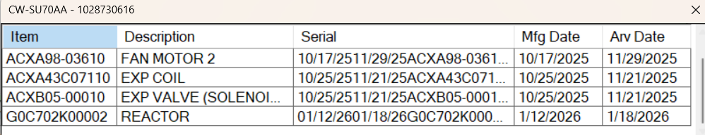
DATA LOGGER PROJECT
B. Plan for the Day (Quantity)
COMPRESSOR
A. Scanning (Model and Serial)
C. Details of Scanned
Scan first every change model, the other parts

Slide 3
DATA LOGGER PROJECT
COMPRESSOR
Scanning (Model and Serial)
  This is where information of the model and serial that was scanned goes.
  Information of compressor and Fan motor will be saved
  This part will help judge if the fan motor and compressor that will be used in the unit is right (good or not)
B. Plan for the Day (Quantity)
  This part shows the current situation in terms of quantity
  This quantity represents the variance vs. plans in the specific module or part
C. Details of Scanned
  This is all where all the data of the scanned information will be shown.
  There is a tab for details. This shows the other materials that were used in the unit.
    The scanning of these parts happens before every start of model change (should be right)

Slide 4
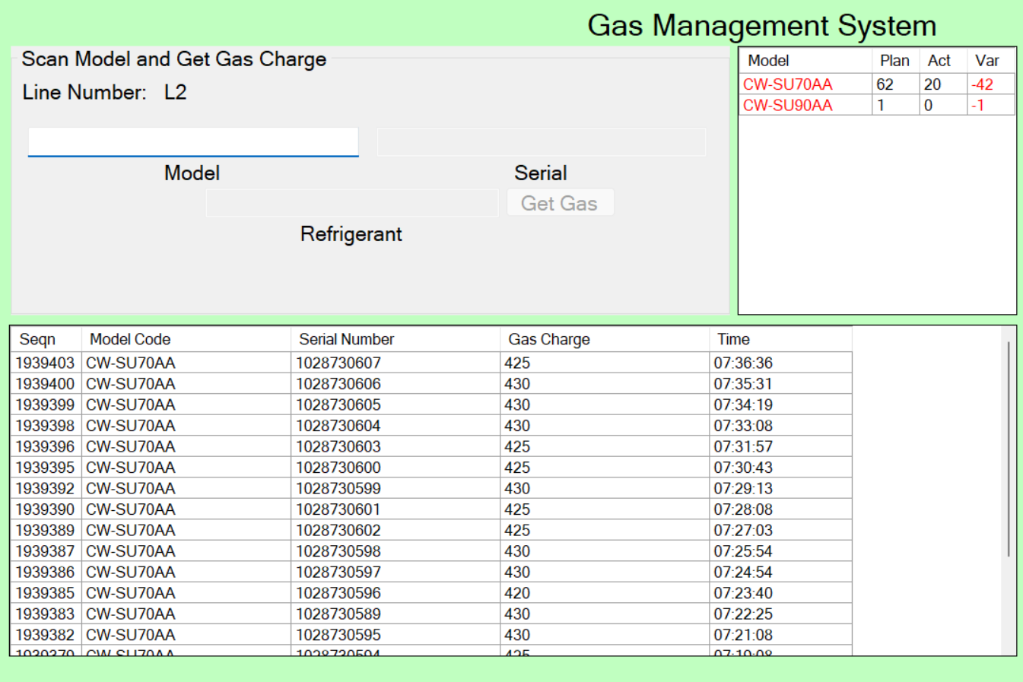
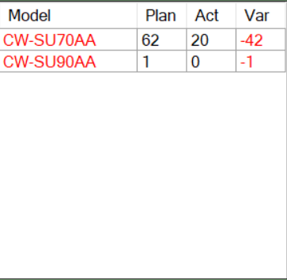
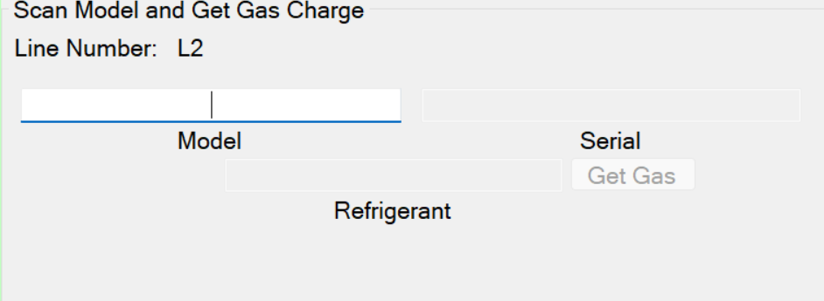
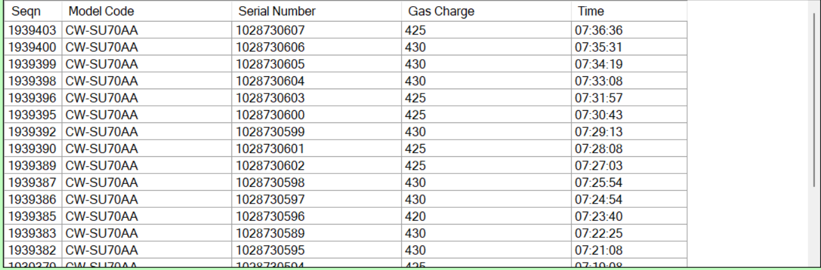
DATA LOGGER PROJECT
B. Plan for the Day (Quantity)
GAS CHARGING
A. Scanning (Model and Serial)
C. Details of Scanned

Slide 5
DATA LOGGER PROJECT
GAS CHARGING
Scanning (Model and Serial)
  This is where information of the model and serial that was scanned goes.
B. Plan for the Day (Quantity)
  This part shows the current situation in terms of quantity
  This quantity represents the variance vs. plans in the specific module or part
C. Details of Scanned
  Data for scanned of gas charge (weight of the gas charged in the unit)

Slide 6
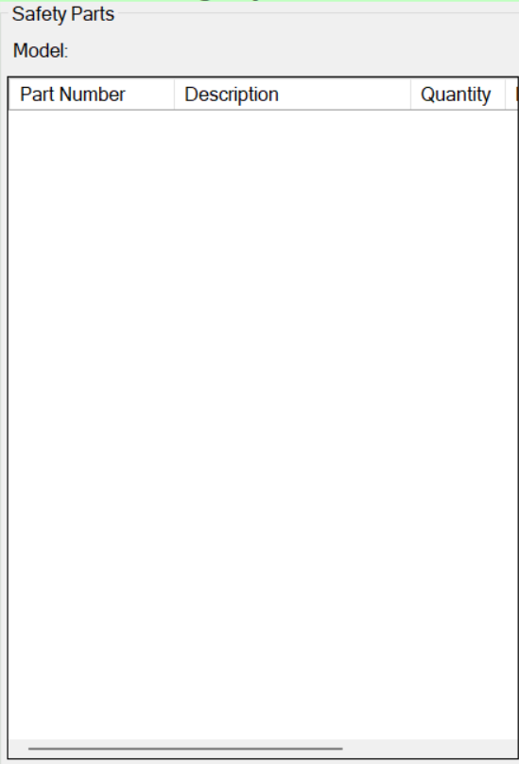
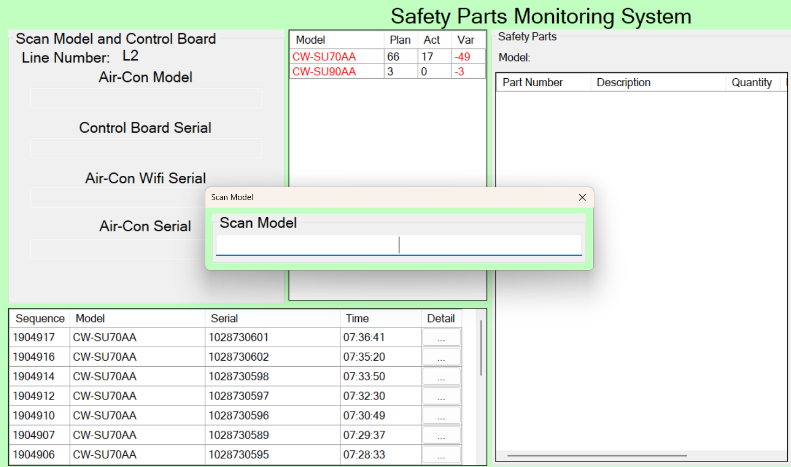
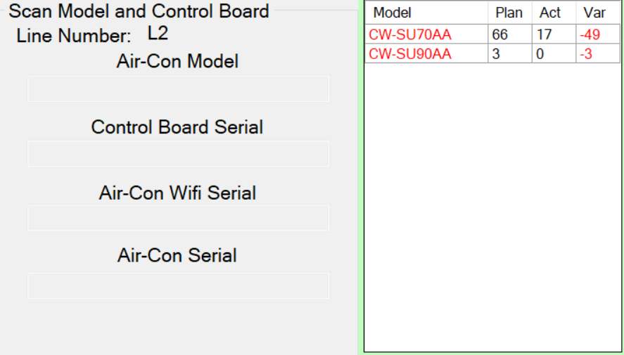
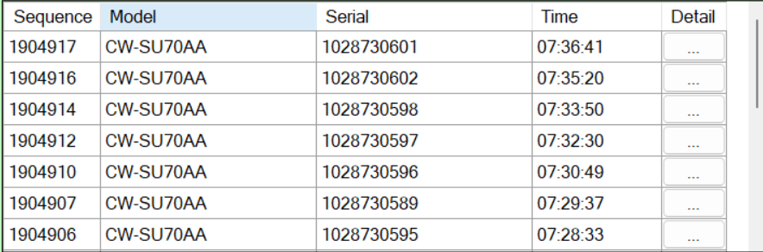
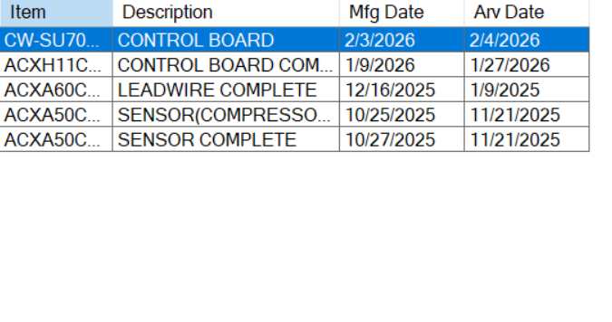
DATA LOGGER PROJECT
B. Plan for the Day (Quantity)
INNER LINE
A. Scanning (Model and Serial)
C. Details of Scanned
Scan first every change model, the other parts

Slide 7
DATA LOGGER PROJECT
INNER LINE
Scanning (Model and Serial)
  This is where information of the model and serial that was scanned goes.
  Information of what should be used in the part shows
B. Plan for the Day (Quantity)
  This part shows the current situation in terms of quantity
  This quantity represents the variance vs. plans in the specific module or part
C. Details of Scanned
  This is all where all the data of the scanned information will be shown.
  There is a tab for details. This shows the other materials that were used in the unit.
    The scanning of these parts happens before every start of model change (should be right)

Slide 8
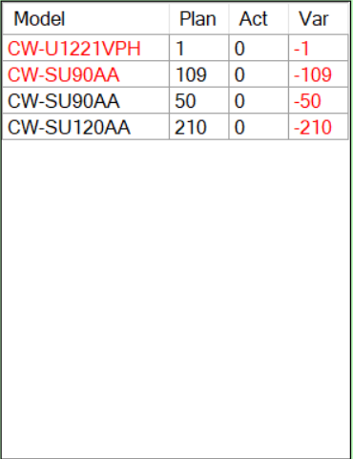
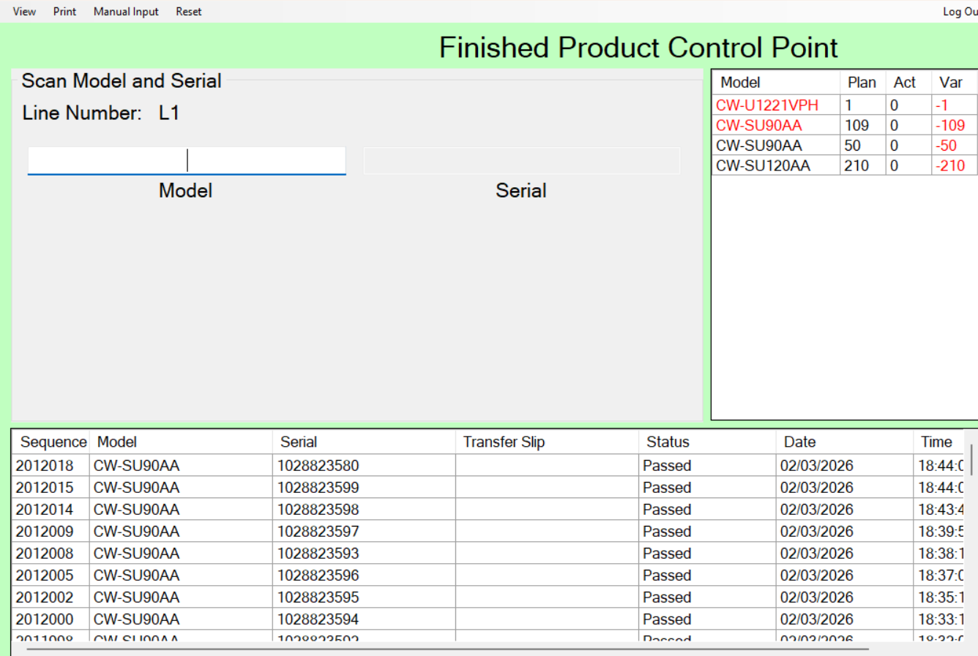
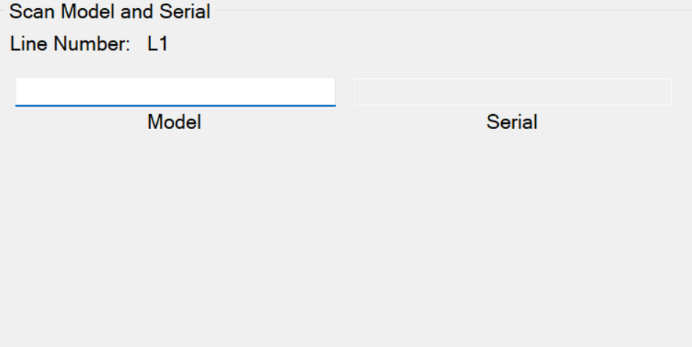
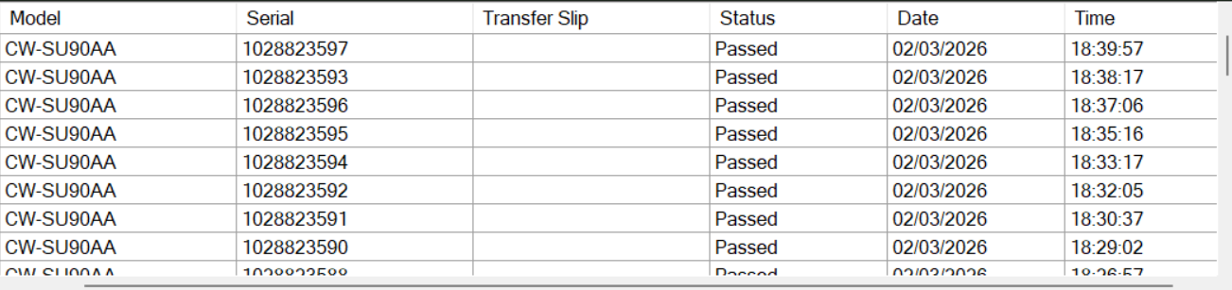
DATA LOGGER PROJECT
B. Plan for the Day (Quantity)
FINISHED GOODS
A. Scanning (Model and Serial)
C. Details of Scanned

Slide 9
DATA LOGGER PROJECT
FINISHED GOODS
Scanning (Model and Serial)
  This is where information of the model and serial that was scanned goes.
B. Plan for the Day (Quantity)
  This part shows the current situation in terms of quantity
  This quantity represents the variance vs. plans in the specific module or part
C. Details of Scanned
  Data for scanned of carton box should show
  Details whether the item has been transferred or not (Transfer Slip)

Slide 10
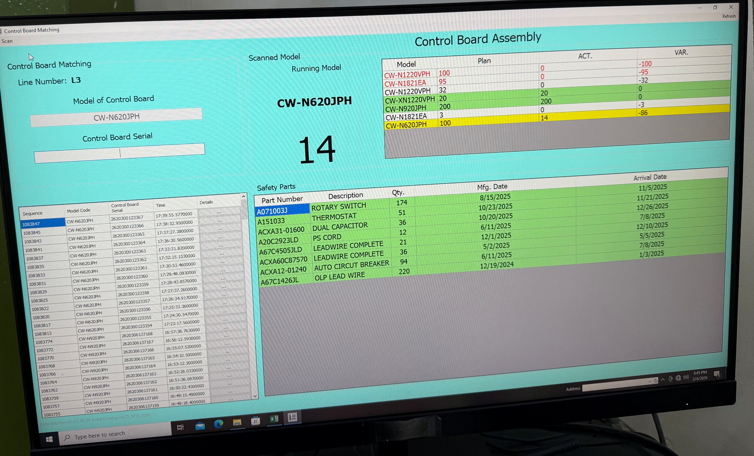
DATA LOGGER PROJECT
CONTROL BOARD
A. Scanning (Model and Serial)
B. Done Control Board (Quantity)
C. Plan for the Day (Quantity)
D. Scanned Complete Control Board
E. Scanned Parts (with quantity)

Slide 11
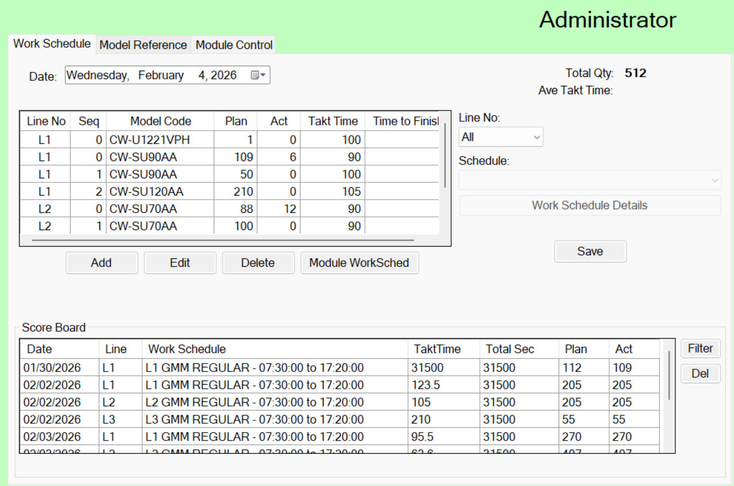
DATA LOGGER PROJECT (ADMINISTRATOR)
A. Daily Schedule
Takt Time: Important
For repair option
Reset per day the plan
Control Board

Slide 12
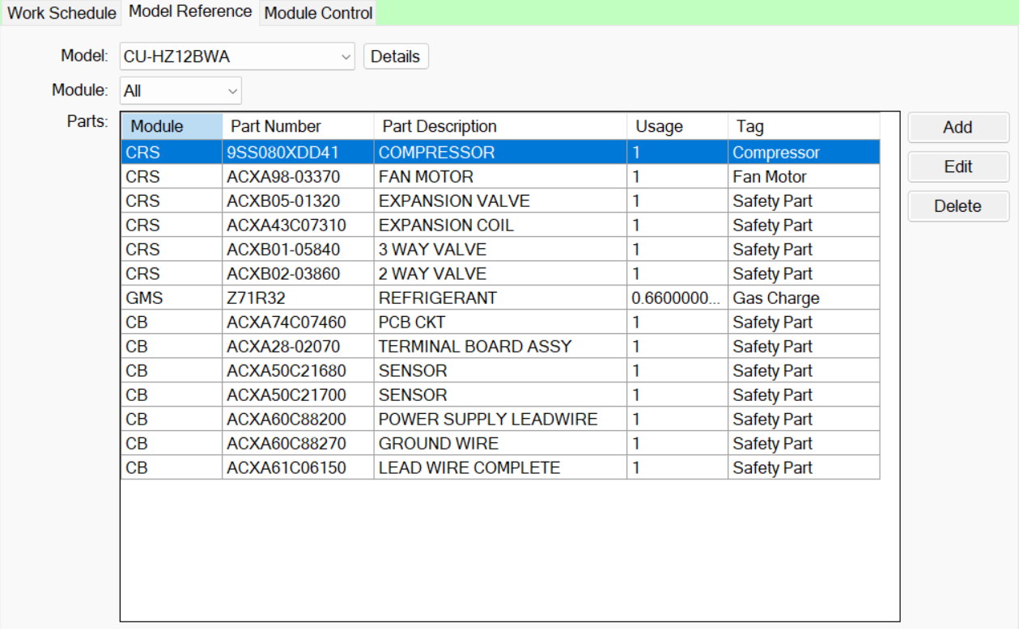
DATA LOGGER PROJECT (ADMINISTRATOR)
Details for each Model

Slide 13
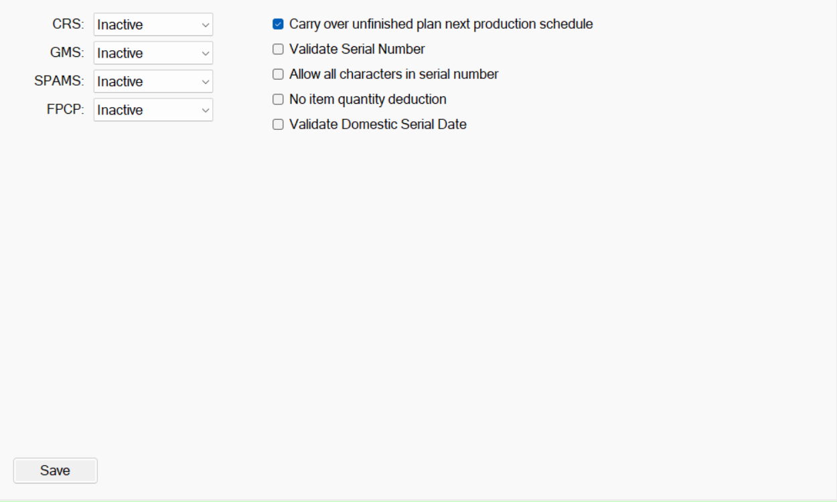
DATA LOGGER PROJECT (ADMINISTRATOR)

Slide 14
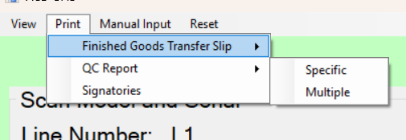
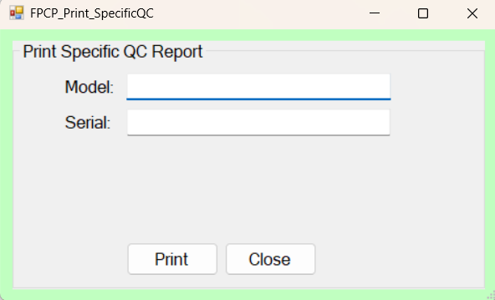
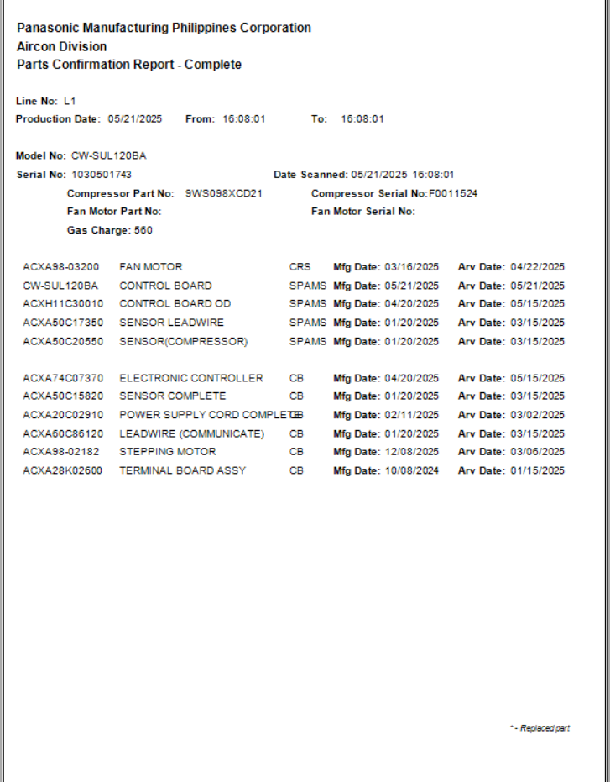
DATA LOGGER PROJECT (FINISHED GOODS)

Slide 15
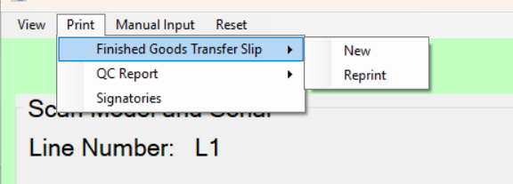
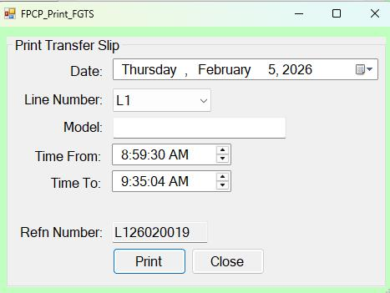
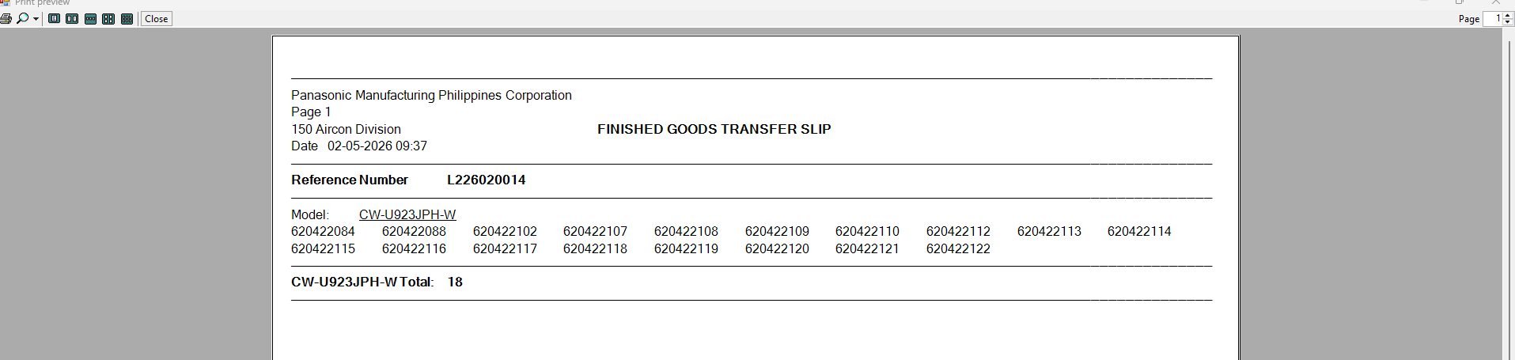
DATA LOGGER PROJECT (FINISHED GOODS)

